Slide 1
Instantaneous velocity measurement
# Under the supervision of
DR/ Gamal Eldsoqy

Slide 2
• Created by:
1- Mahmoud Abdelrahman Mohamed
2-Bemin Magdy

Slide 3
Introduction
There are definite rules laid out by authorities about driving cars on roads. The most common rule in any country is speed limit in certain roads . you will be in violation of the law if your car speed exceeds this limit.
In order to detect the speed of a moving car, the patrolling officers usually depend on a handheld gun that works on Radar Technology or Lidar Technology. This is a tedious process as the officer has to manually check for over speeding for each vehicle.
What if the Car Speed Detection is made automatic? A simple automatic detection of speed of a vehicle is designed in Arduino Car Speed Detector project, where you can place the system in one place and view the results instantly without any human intervention

Slide 4
Principle of the Project :
IR Sensors are the main part of the project that detect
the speed of a car. Practically, you can implement the
setup of IR Sensors in many ways but in this project, I
have used two reflective type IR Sensors and placed
them 10 cm apart.
When a car travelling reaches the first sensor, the IR
Sensor gets activated. From this moment onward, a
timer is initiated and will continue to keep time until the
car reaches the second IR Sensor. you can calculate the speed at which the car travelled from IR Sensor 1 to IR Sensor 2 as you already know the time of travel.
All the calculations and data gathering are done by
Arduino and the final result is displayed on a 16X2 LCD
Module.

Slide 5
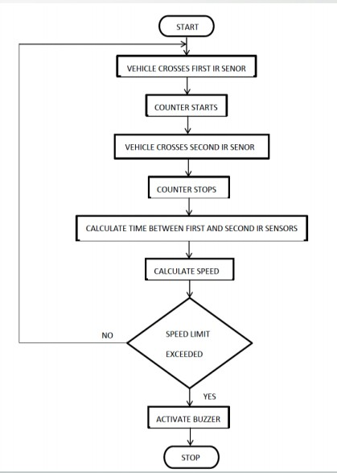

Slide 6
• Components Required
Arduino UNO
IR Sensors x 2
16X2 LCD Display Module
Breadboard
Connecting Wires
Power Supply
Resistors

Slide 7
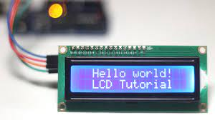
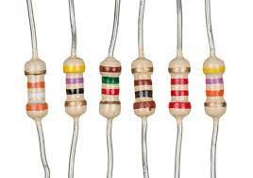
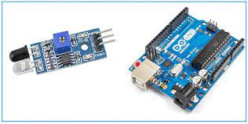

Slide 8
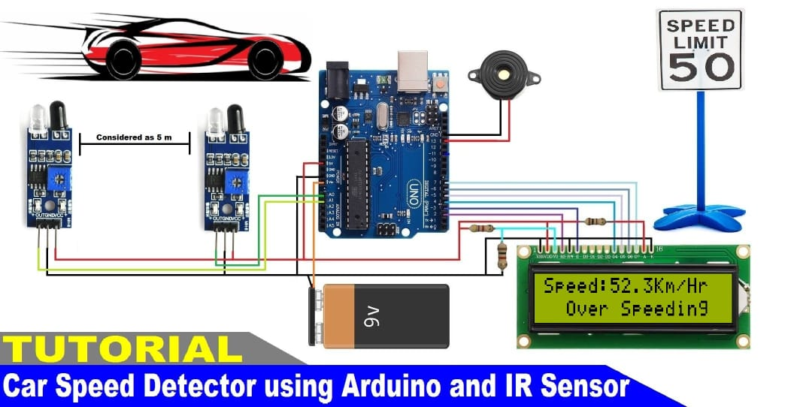
• Electric Circuit Of the project :

Slide 9
IR sensor
First of all, I have used two digital IR Sensors, which consists of an IR Transmitter (IR LED), an IR Receiver (Photo Diode), a Comparator IC and a few supporting components. The IR Transmitter and Receiver Pair are placed side-by-side so that they form a Reflective Type IR Sensor.
In this type, the IR Transmitter continuously emits Infrared radiations and if there is no object in front of the sensor, none of the Infrared radiation gets reflected back to the IR Receiver.
Interfacing IR Sensor with Raspberry Pi IR Sensor But if there is an object in front of the sensor, some of the infrared radiation hits the object and gets reflected back. This reflected radiation falls on the IR Receiver, which means that the sensor has detected the object.

Slide 10
How to operate Arduino Car Speed Detector Project?
- Make all the necessary connections with respect to the circuit diagram and upload the code to Arduino.
- Place the two IR Sensors on the edge of the breadboard so that the distance between them is approximately 10 centimeters.
- Simulate a car movement in front of the sensors either by using your hands or a toy car.
- Arduino calculates the speed and displays the result on the 16×2 LCD

Slide 11
Working
1- Connect the ground of all components together to the ground on the Arduino .
2- We connect the output of the IR sensor to A0, A1 on the Arduino .
3- We connect the battery positive to the Vin input on the Arduino .
4- The buzzer is connected to the digital output .
5- we connect the pins of the LCD to the Arduino .

Slide 12


